Slide 1







Multi-variate Linear Regression
Learning with Loss, Cost Functions, for One Sample
21010469 김민경

Slide 2

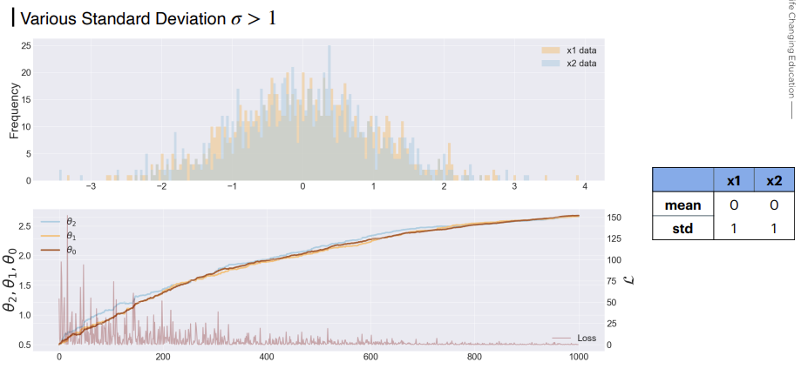

Learning with Loss
02

Slide 3
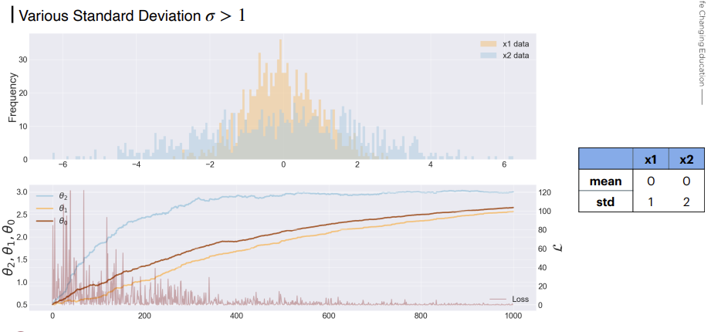

Learning with Loss
03

Slide 4
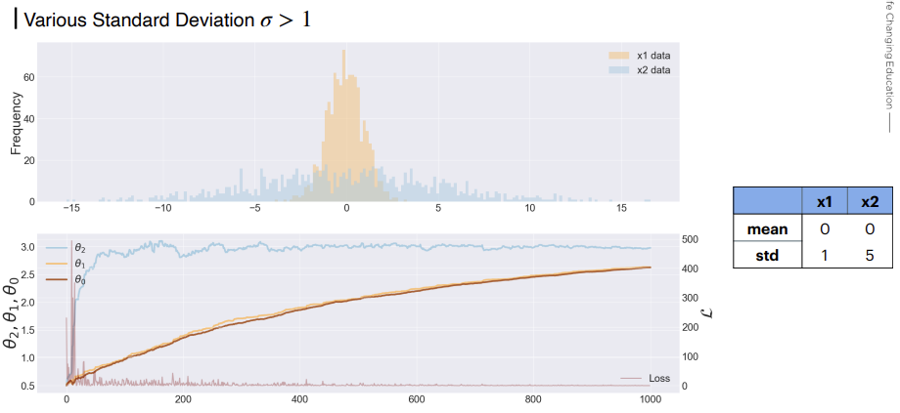
Learning with Loss
04

Slide 5
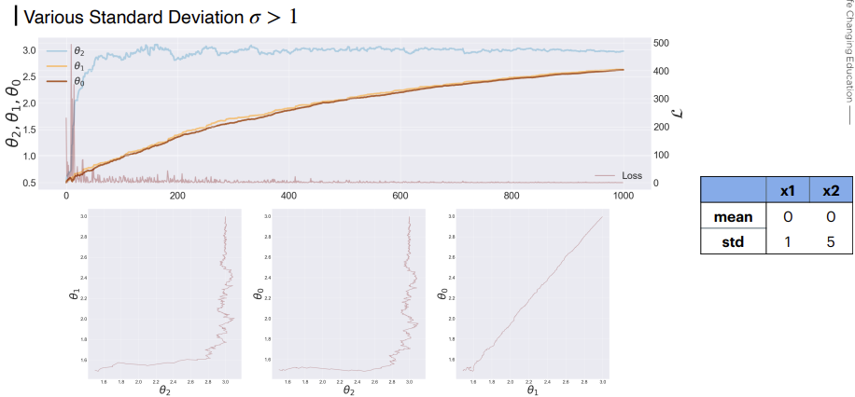
Learning with Loss
05

Slide 6
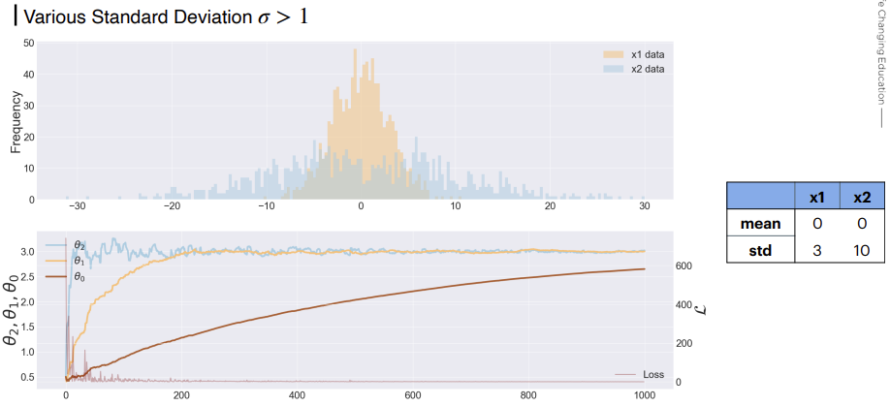
Learning with Loss
06

Slide 7
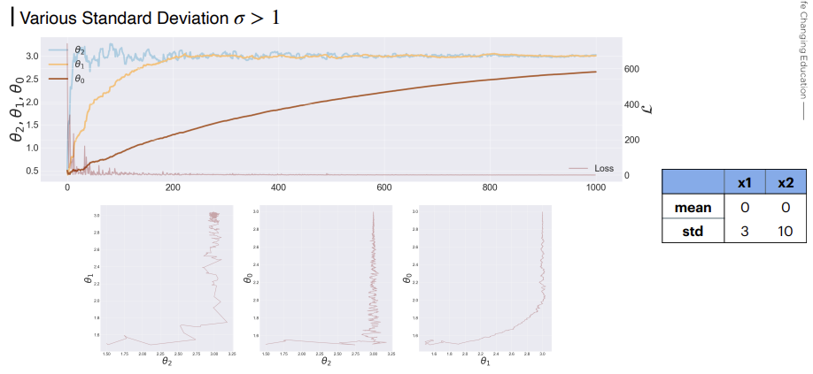
Learning with Loss
07

Slide 8
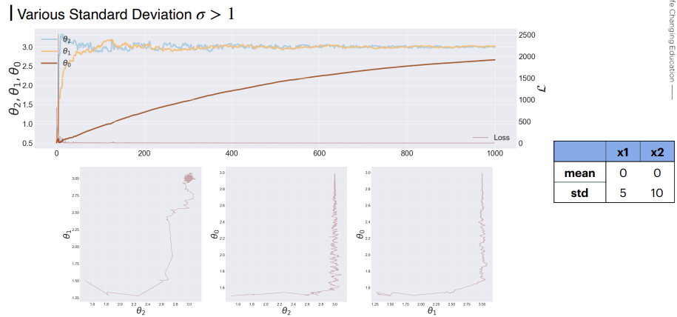
Learning with Loss
08

Slide 9
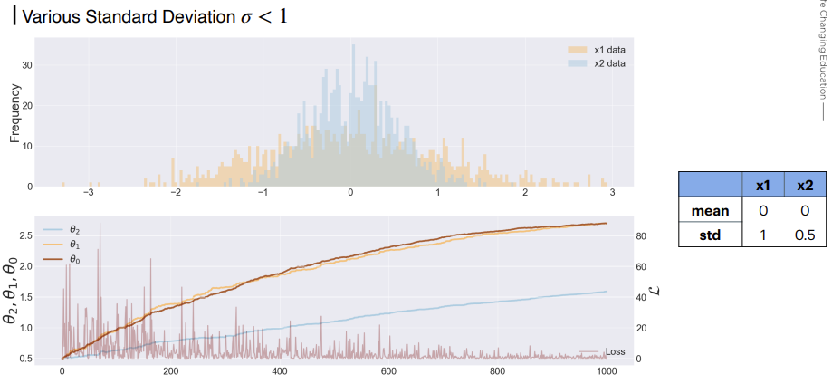
Learning with Loss
09

Slide 10
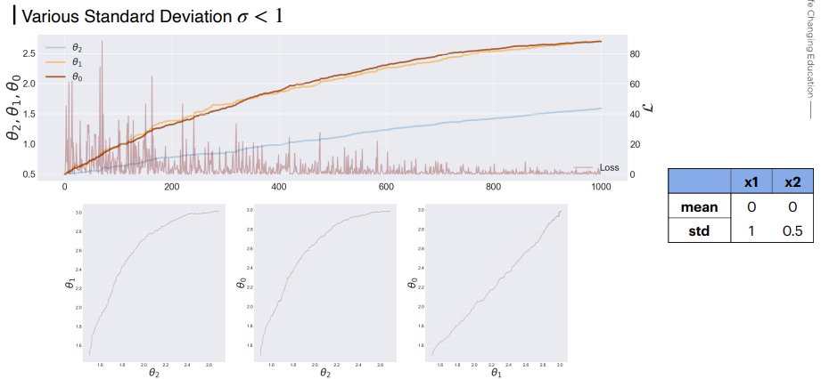
Learning with Loss
10

Slide 11
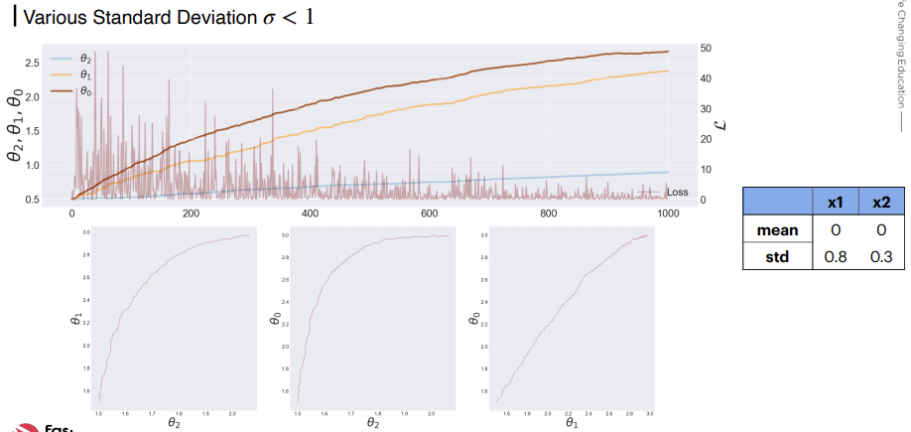

Learning with Loss
11

Slide 12
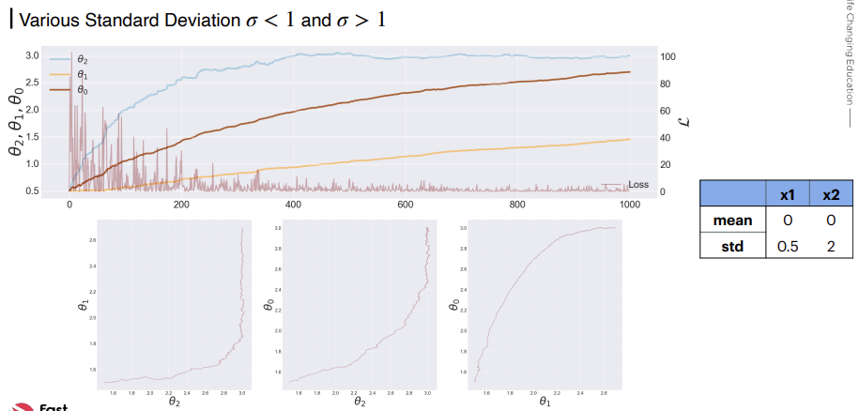
Learning with Loss
12

Slide 13
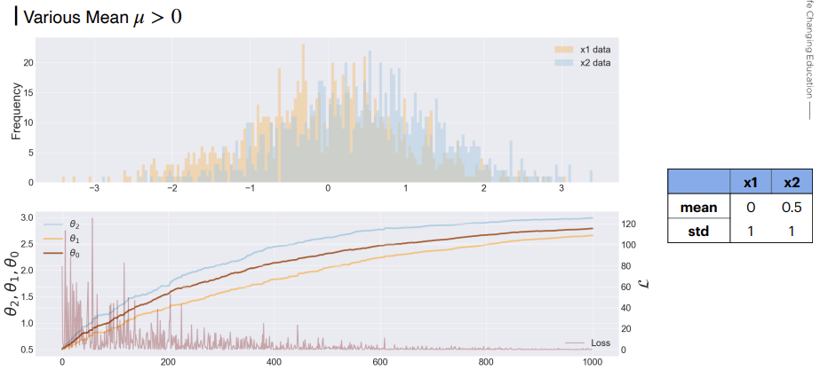
Learning with Loss
13

Slide 14
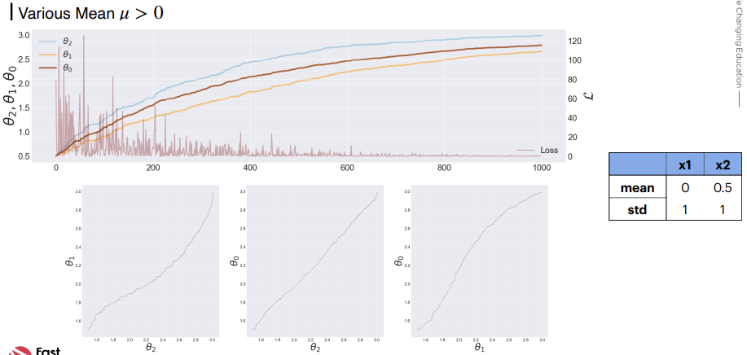
Learning with Loss
14

Slide 15
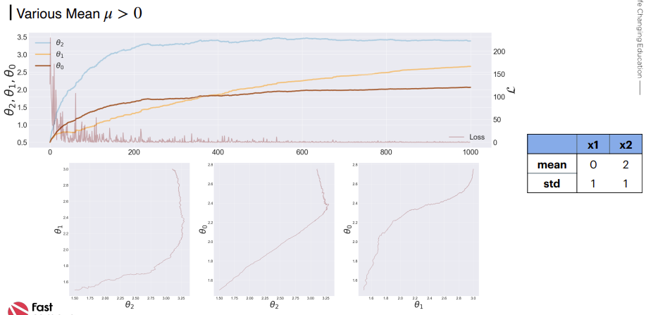
Learning with Loss
15

Slide 16
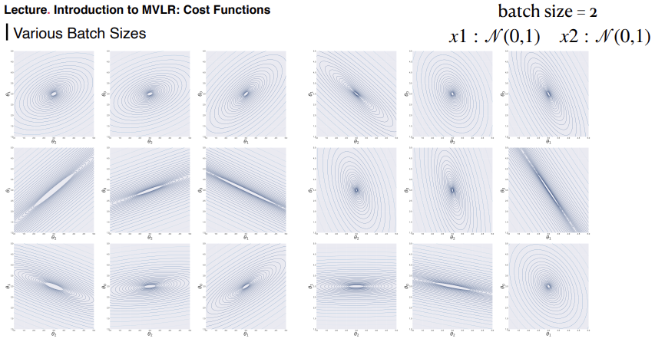
Cost Functions
16

Slide 17
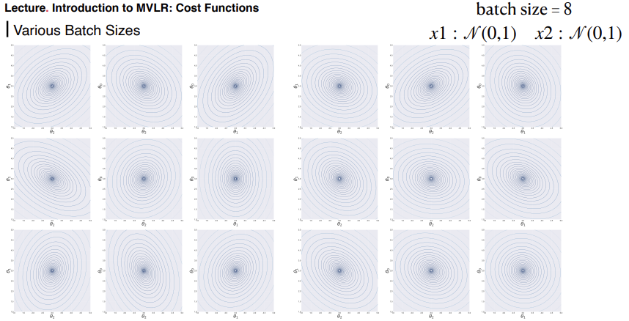
Cost Functions
17

Slide 18
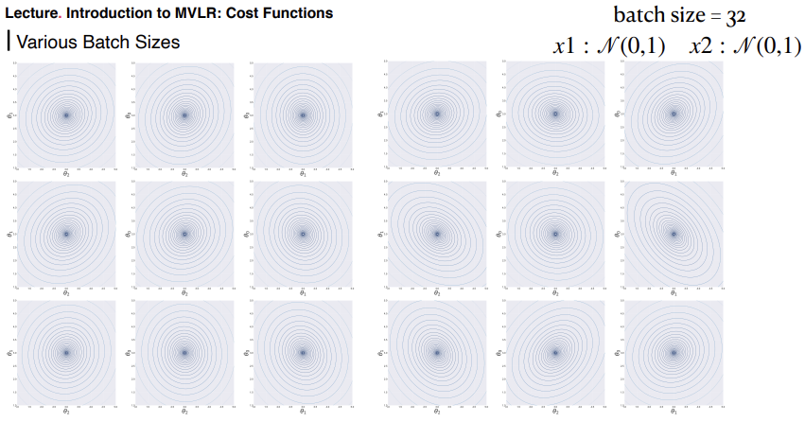
Cost Functions
18

Slide 19
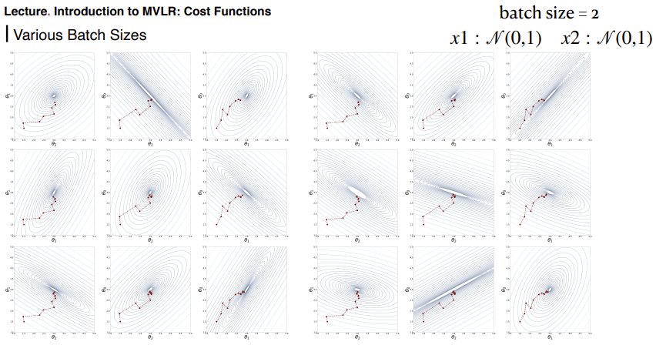
Cost Functions
19

Slide 20
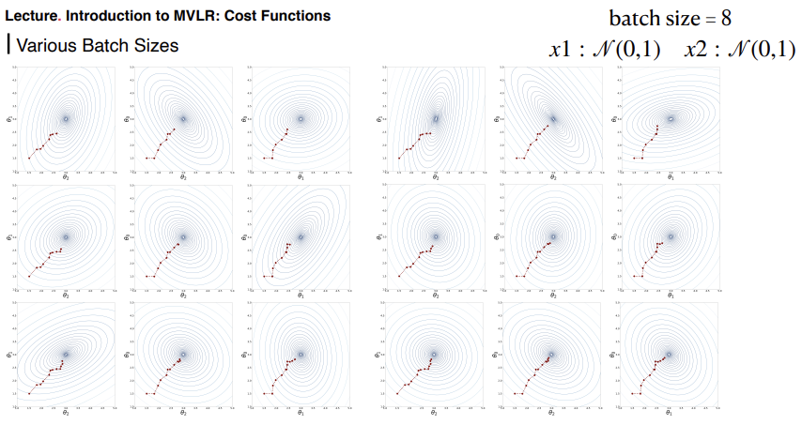
Cost Functions
20

Slide 21
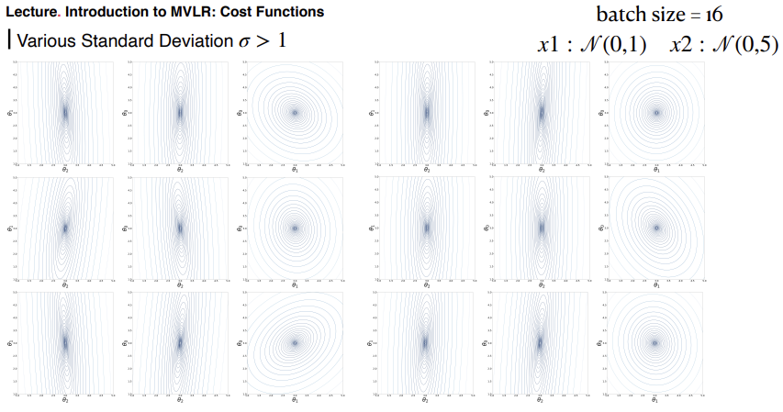
Cost Functions
21

Slide 22
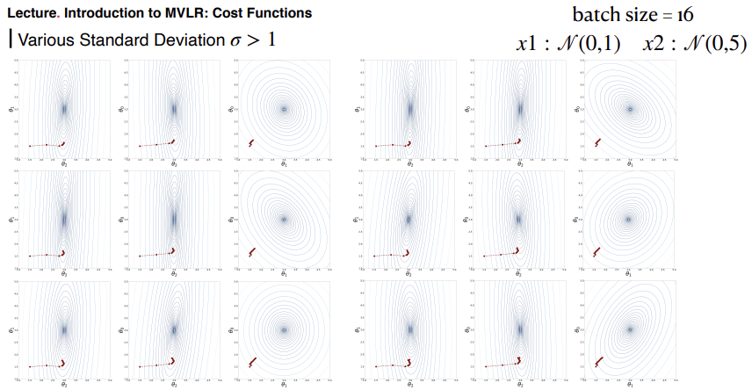
Cost Functions
22

Slide 23
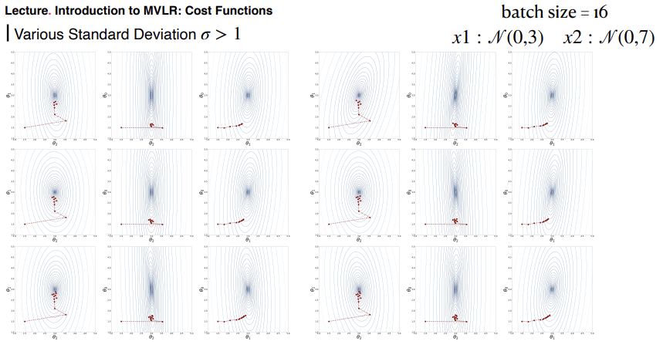
Cost Functions
23

Slide 24
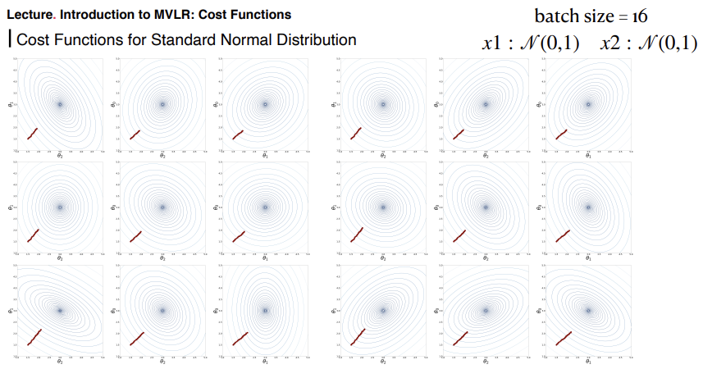
Cost Functions
24

Slide 25
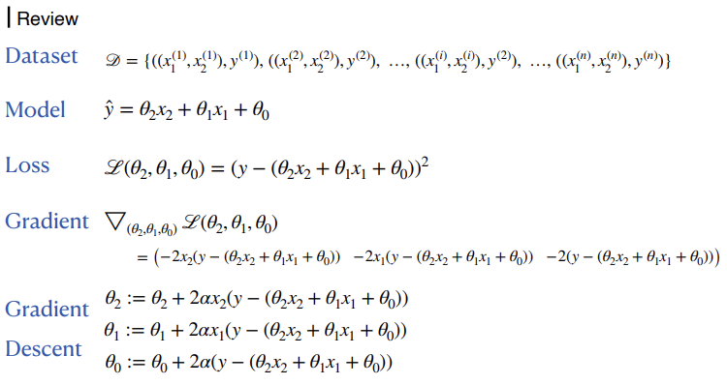
One sample: Theory
25

Slide 26
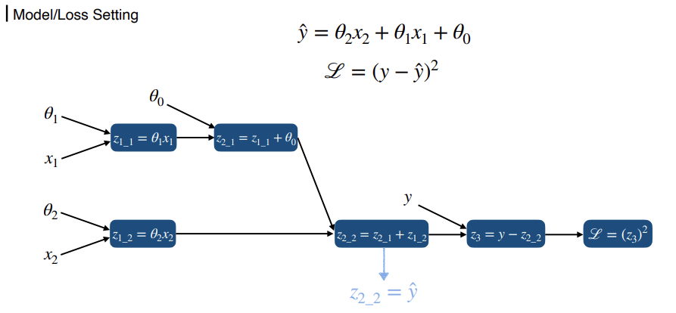
One sample: Theory
26

Slide 27
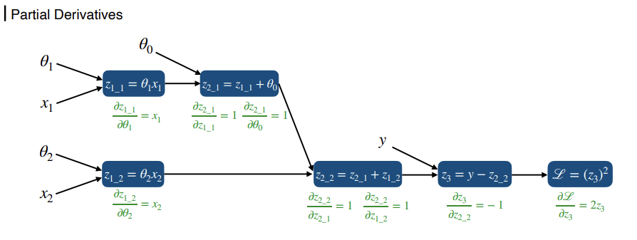
One sample: Theory
27

Slide 28
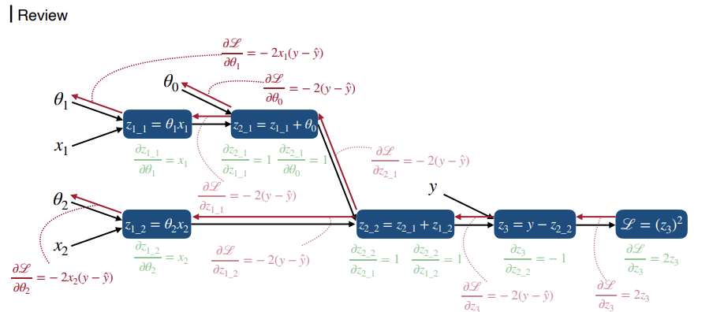
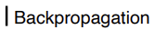
One sample: Theory
28

Slide 29
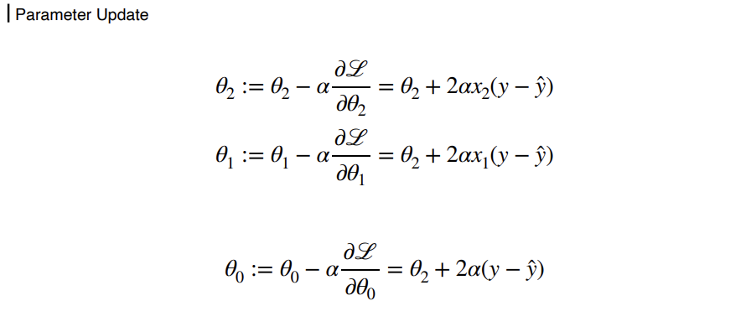
One sample: Theory
29

Slide 30
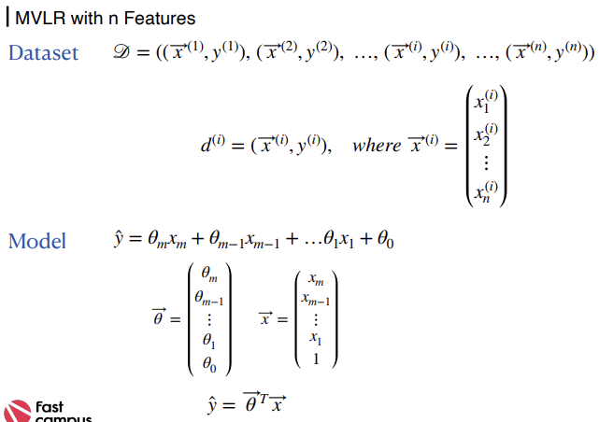

One sample: Theory
30

Slide 31
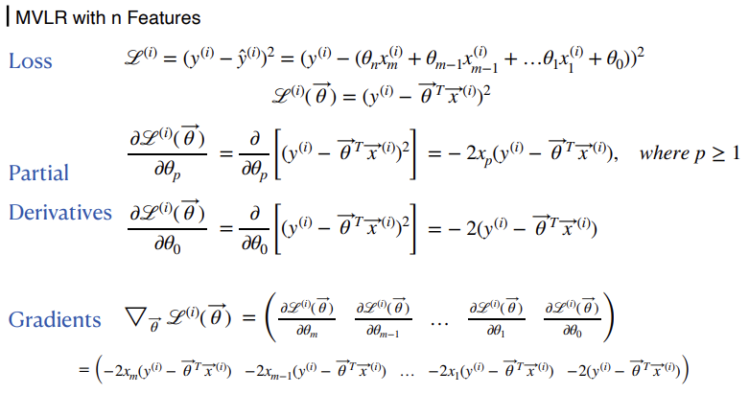
One sample: Theory
31

Slide 32
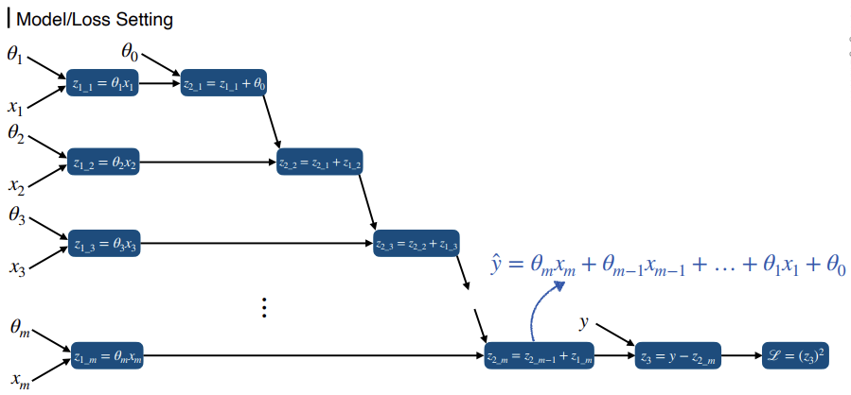
One sample: Theory
32

Slide 33
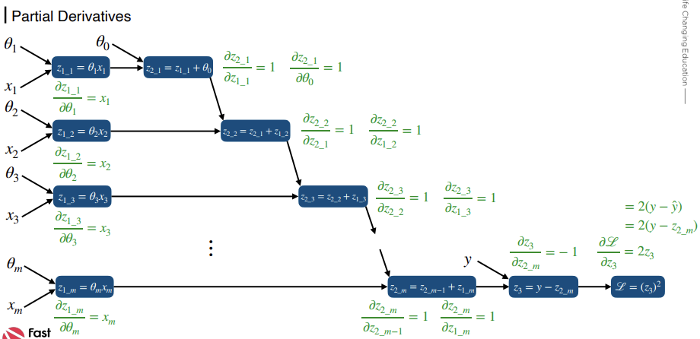
One sample: Theory
33

Slide 34
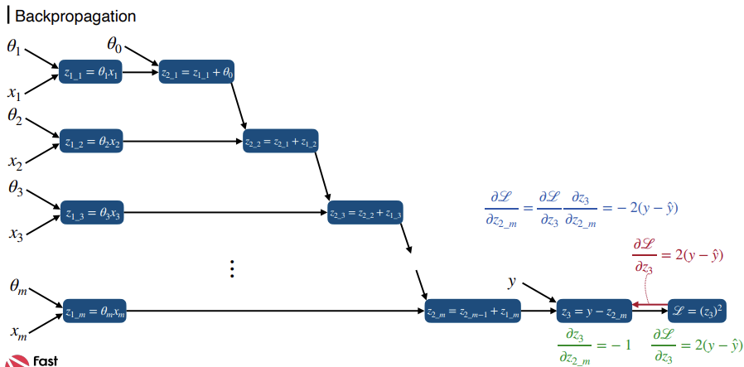
One sample: Theory
34

Slide 35
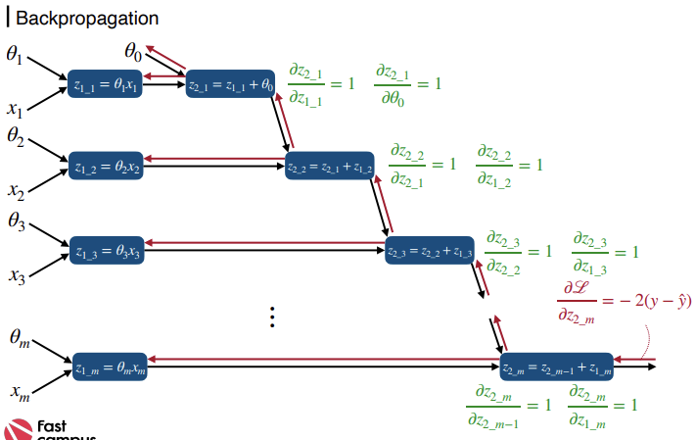
One sample: Theory
35

Slide 36
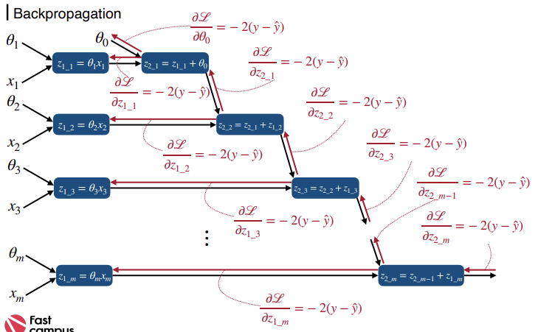
One sample: Theory
36

Slide 37
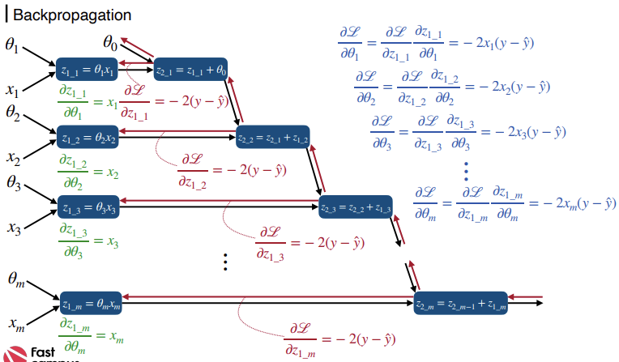
One sample: Theory
37

Slide 38
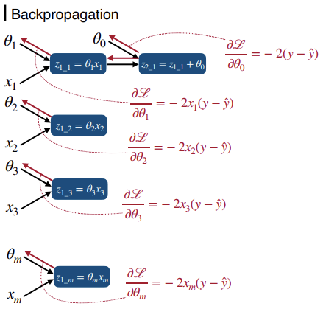
One sample: Theory
38

Slide 39



THANKS FOR WATCHING

